Slide 1
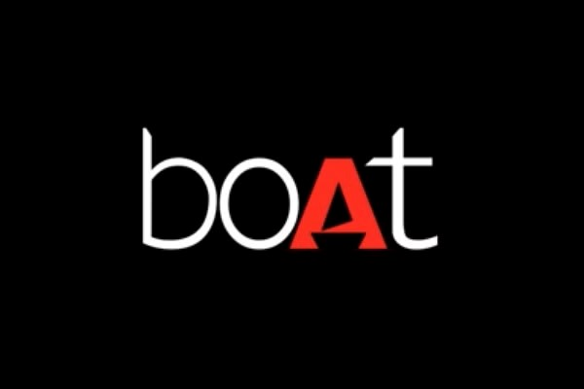
Comprehensive Digital marketing for BOAT Lifestyle
Team DETAILS
TEAM LEADER: SMARAK KUMAR NAYAK
N HARIKRISHNA
ABDUL KARIM
KANCHU PARDHA SARADHI
K BALA MURALI KRISHNA
VUDA SAI TARUN

Slide 2
Team Members Acknowledgement
I am Smarak Kumar Nayak, as a Team leader I have done the following work.
1.Power point presentation
2.Brand study
3.Competetor Analysis
4.Buyer’s persona

Slide 3
N HARI KRISHNA, has done the following work:
1.power point presentation
2.Social media marketing and insights
3.Content ideas and marketing strategies

Slide 4
ABDUL KARIM has done the following work:
1.Power point presentation
2.Content ideas and marketing strategies
3.Brand study

Slide 5
KANCHU PARDHA SARADHI has done the following work:
1.Post creation
2.Designing and editing video
3.Social media Ad campaign

Slide 6
VUDA SAI TARUN
1.SEO AUDIT ( SEARCH ENGINE OPTIMIZTION)
2.KEYWORD RESEARCH
3.ON PAGE OPTIMIZATION

Slide 7
K BALA MURALI KRISHNA has done the following work:
1.Content idea generation
2.Brand identity research
3.E mail Add campaigns

Slide 8
ABOUT THE PROJECT
Company/topic of the project: boAt life style
Brand Logo:
Brand colours: Red Black and white
Brand Tagline: “PLUG INTO NIRVANA”
Founders of the company bOAt : SAMEER MEHTA AND AMAN GUPTA
Brand website: https//www.bOAt-lifestyle.com

Slide 9
ABOUT bOAt
The boAt is an Indian company that deals with audio tech that mainly focuses on products like wireless speakers, earbuds, smartwatches, headsets, and earphones. All of them are quite accessible in terms of price. the boAt was founded in the year 2016 by Aman Gupta and Sameer Mehta. The main aim of the company is to provide people with fashionable tech and be a part of their daily lifestyles. Currently, Vivek Gambhir is the CEO of the company.
boAt started its journey with the capital of just INR 30 lacs, which was invested by the founders themselves. As per the reports of 2020, boAt is said to be selling 14,000 to 15,000 of its products daily and has over 2 million customers and has bale to attract the attention of their customers by developing a wide range of earphones, wireless speakers, Airdopes and headphones. The quality and the price make it more approachable to its target audience.

Slide 10
BRAND STUDY
boAt was focused on marketing through digital marketing and social media. It took up many social media influencers to promote the products as well as their brand. Apart from that various celebrities like Cricketers Rishab Pant, Shikhar Dhawan, , Shreyas Iyer were a part of a group of celebrities who endorsed boAt.
Boat uses influencers wisely by partnering with relevant influencers who have a genuine connection with the brand's identity.
One of the critical things that boAt does well is to establish a personal connection with its audience. This is evident in their social media presence, which is very engaging and relatable. They use a mix of humor and SERIOUS business advice to connect with their followers, which has helped them build a strong bond with their target market.

Slide 11
Price and Quality of the Products :
The best factor and one of the reasons that the brand boAt became such a success was its pricing strategy. Neither it is extremely overpriced nor it is unimaginably cheap, it is just in between. The target audience of boAt is mainly youth so they find it perfect to invest in.
Apart from that, even being affordable, boAt has taken special care of the quality of its products; it hasn’t compromised with it even a bit. The current revenue of boAt as per the 2022 financial year is Rs 2,873 cr.

Slide 12
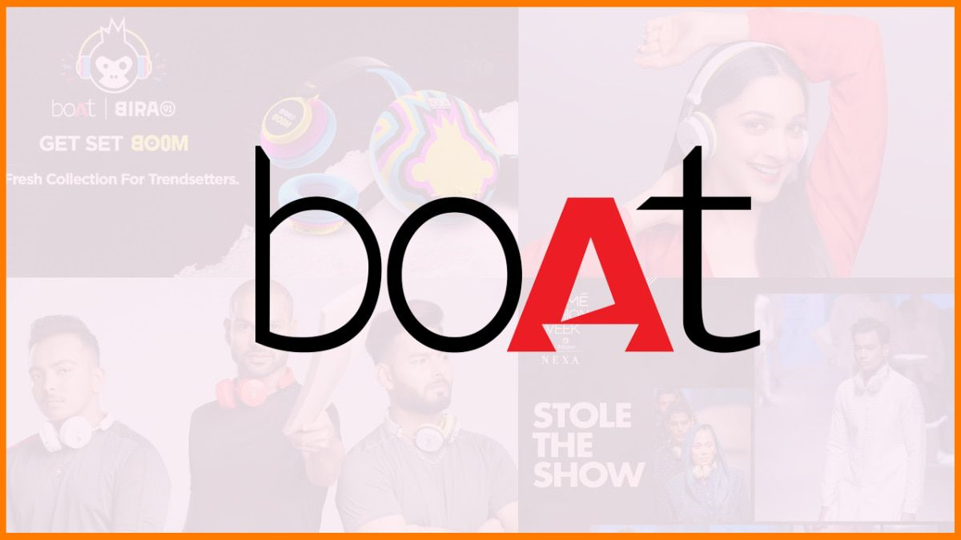
The use of celebrities in promoting boat products in their ad posters.

Slide 13

Target Audience
From the beginning boAt was focused on the youth who are into fitness, they made all the products by keeping their target audience in mind. The demand for indestructible products has been increasing day by day, they understood it and started developing it. Plus with various advertisements, they tried to capture the attention of their target audience.

Slide 14

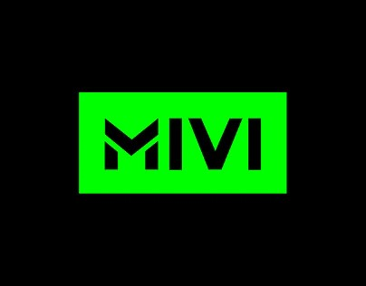


Competitor Analysis of bOAt
bOAt is an INDIAN brand, that manufactures and sells tech related gadgets like smart watches, wireless earphones , earbuds, speakers, headsets etc of great quality ,with an affordable pricing.
Through research we have concluded that boat rises above its competitors because of the combination of great quality with affordability.
There are many competing brands in INDIA that compete with boat and they are mentioned below.

Slide 15
COMPETITORS OF BOAT
Various brands compete with boat and those are listed below.
1. NOISE
2.MIVI
3.BOULT AUDIO
4.FIRE BOLT
5.LEAF
6.SKULLCANDY
7.ZEBRONICS

Slide 16
BUYERS PERSONA
Buyers /customers look for the following common features while going for products sold by Brands like Boat.
1. Affordability
2.Good battery backup
3.Durable
4.Quality
5.Style
6.Customer care support

Slide 17
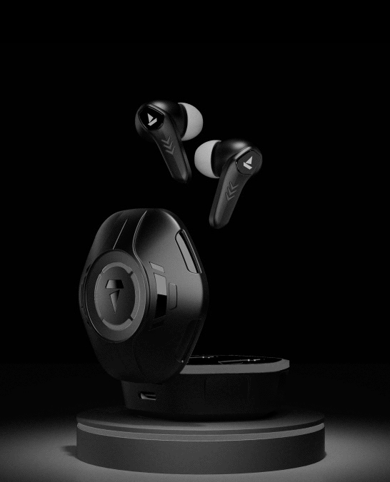
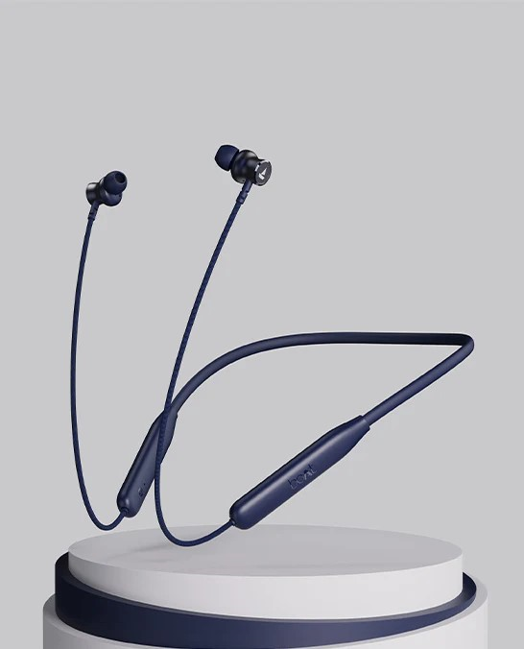
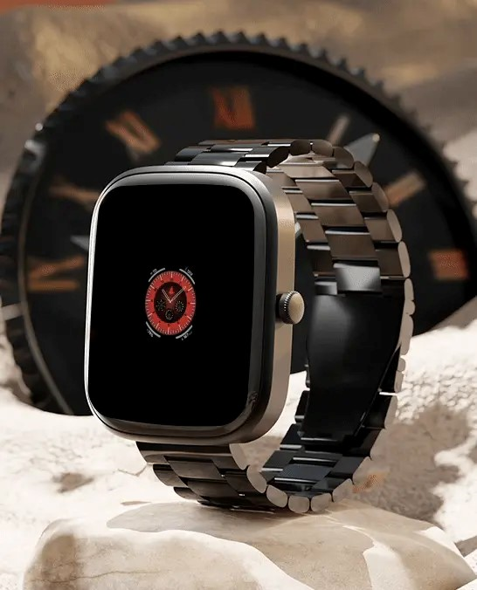
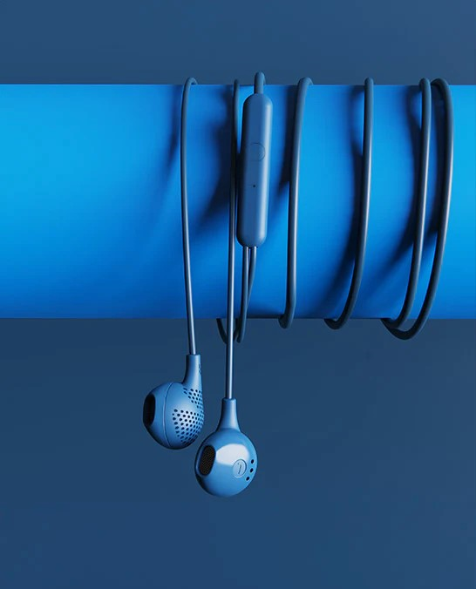
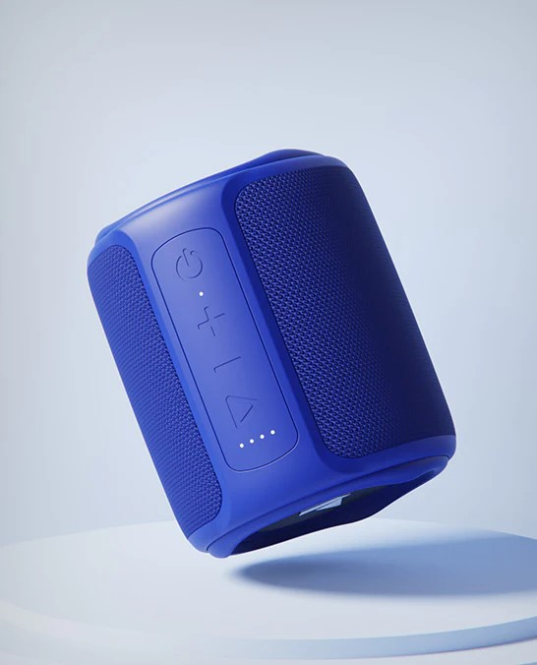
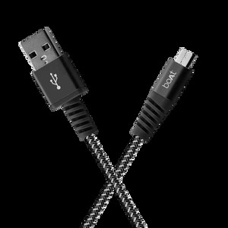
VARIETY OF PRODUCTS SOLD BY BOAT

Slide 18
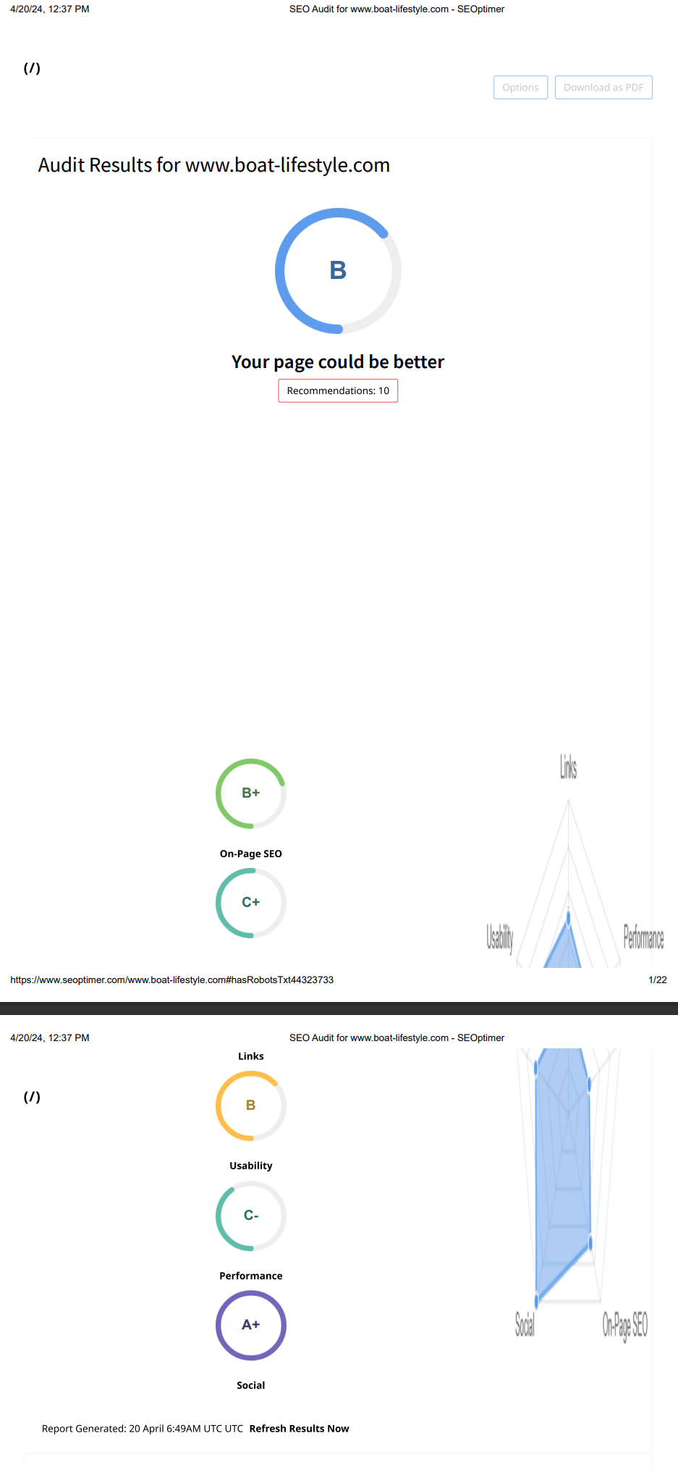
SEO

Slide 19
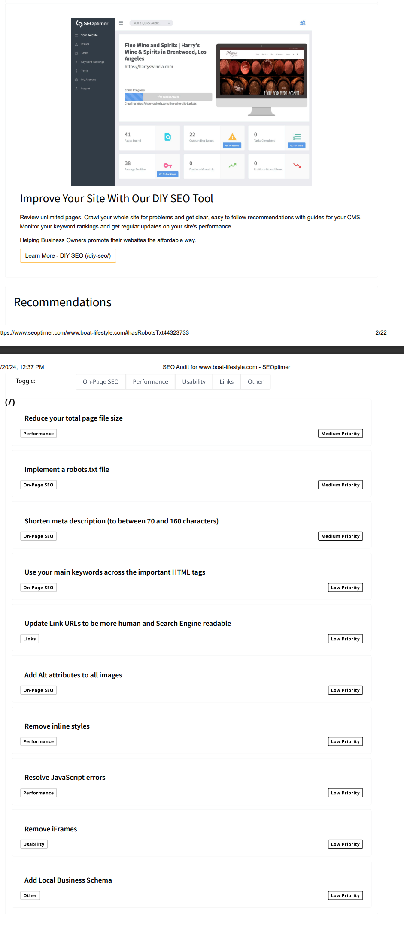

Slide 20
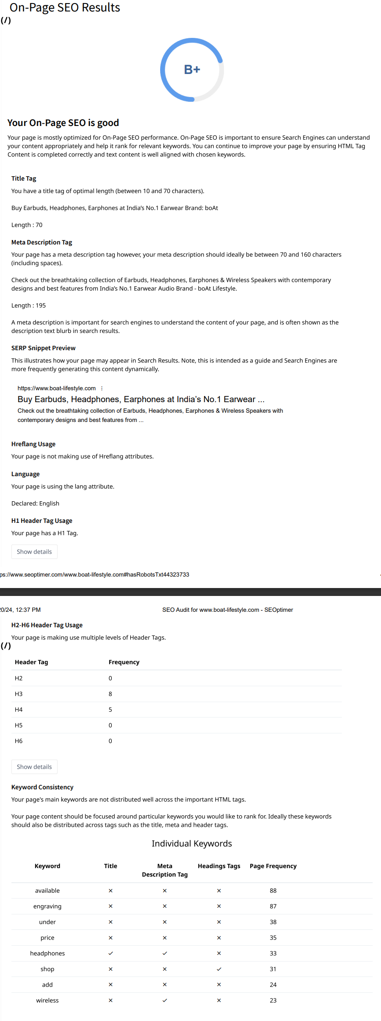

Slide 21
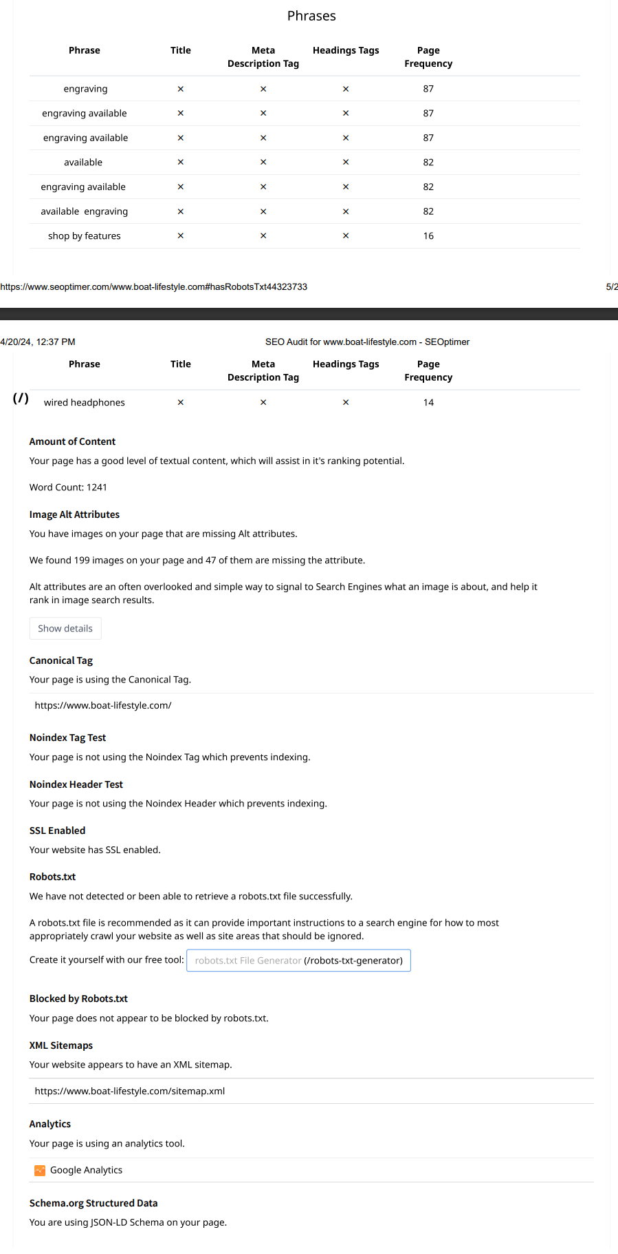

Slide 22
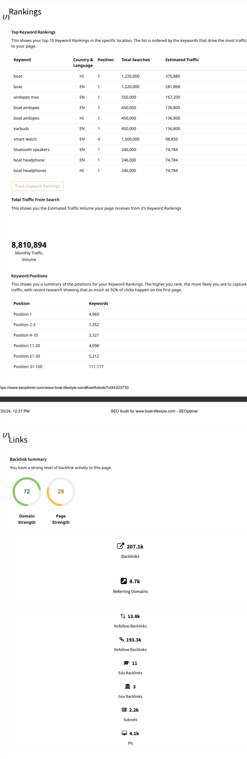

Slide 23
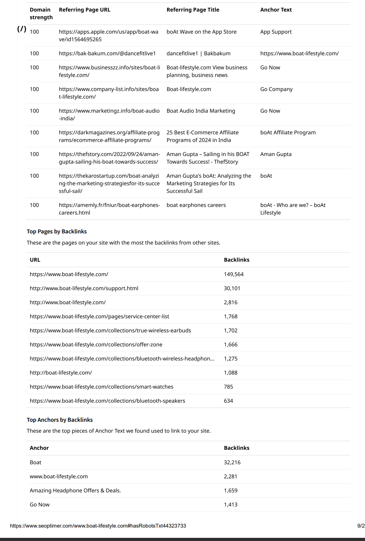

Slide 24
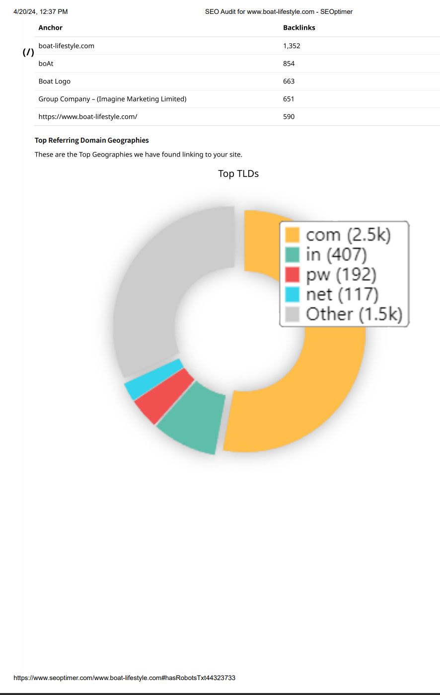

Slide 25
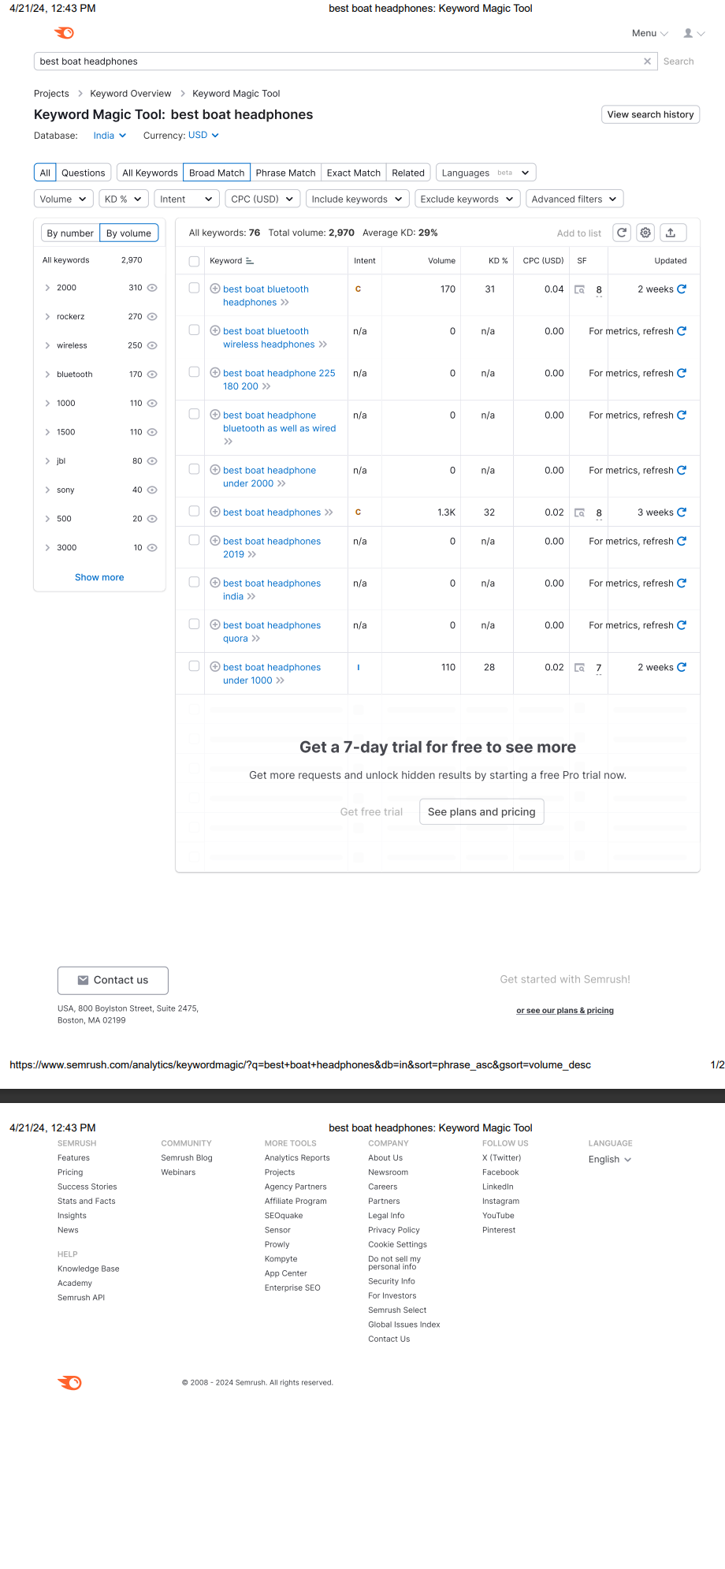
KEYWORDS RESEARCH

Slide 26
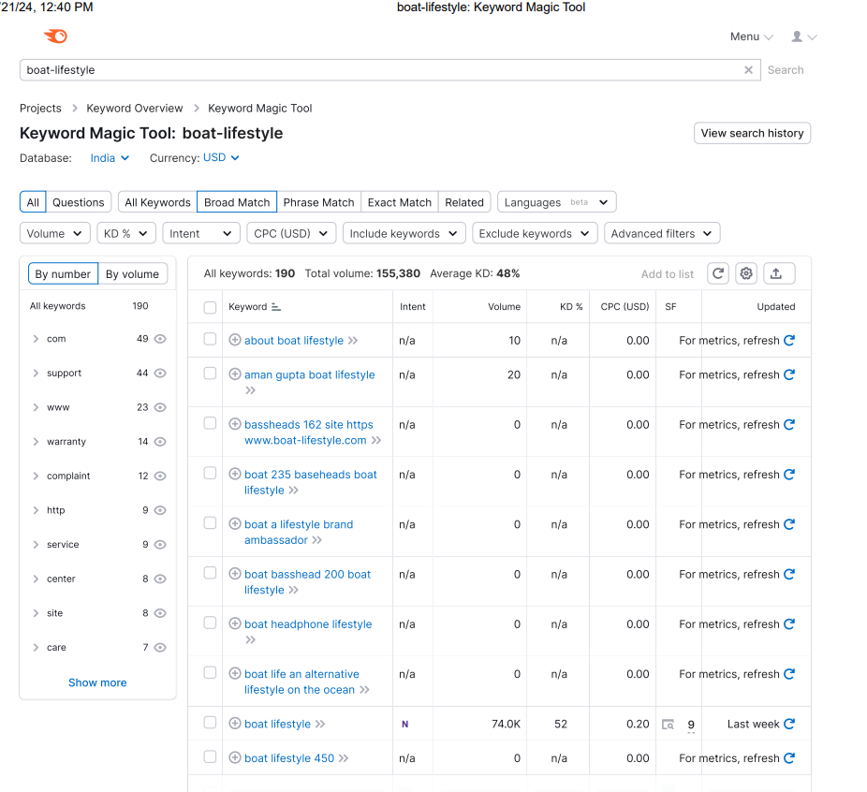

Slide 27
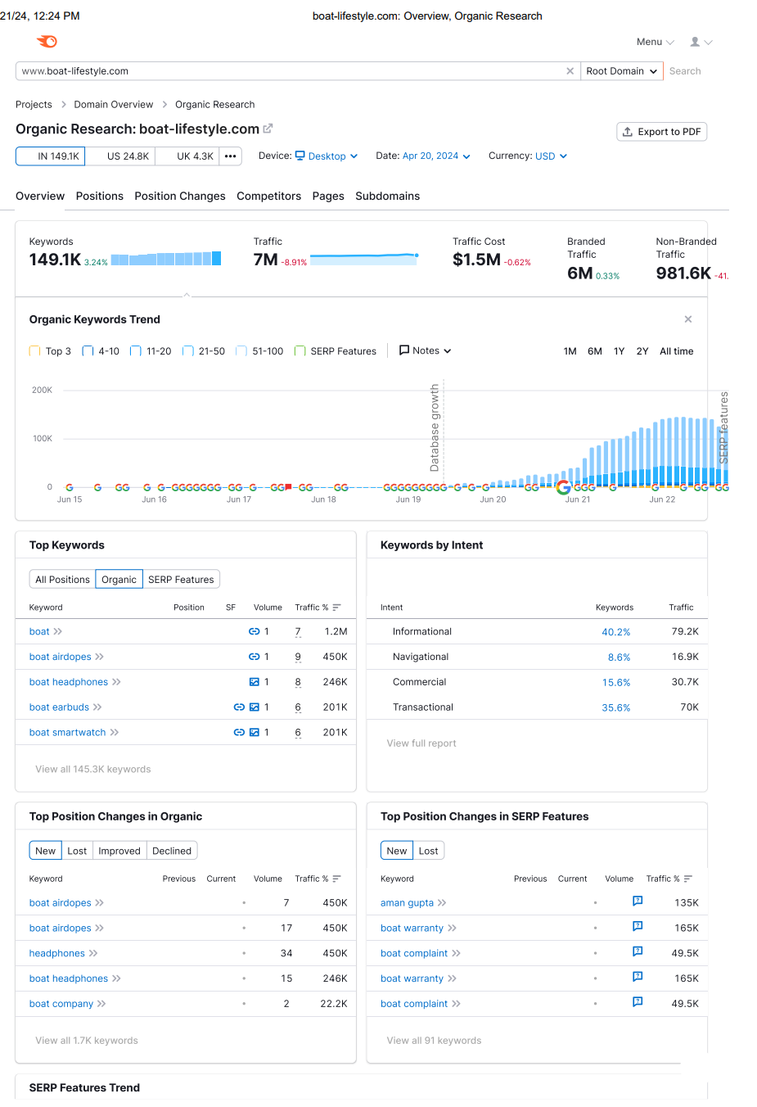

Slide 28
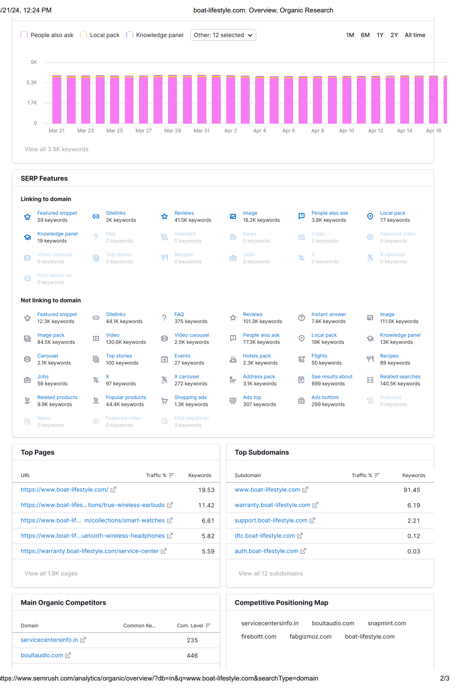

Slide 29
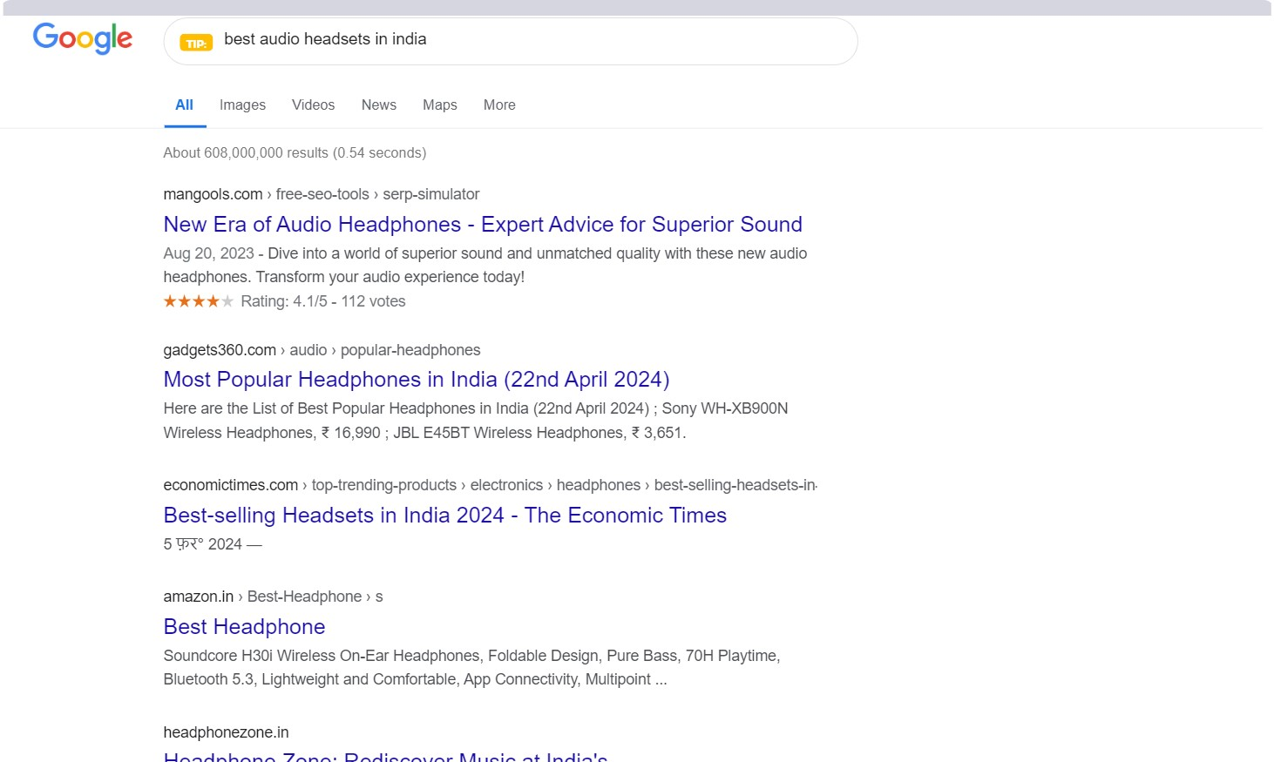

Slide 30
CONTENT IDEAS
WE (I AND MY TEAM) discussed the content and content ideas. My team came up with great many ideas about content creation. I welcomed all teir ideas but we could go with only few one’s. we chose the one’s that were best suited to our abilities.
For content creation, team member saradhi created, edited and posted contents on various social media platforms such as INSTAGRAM,FACEBOOK,EMAIL etc
Saradhi has created advertising posters, trending reels very creatively.
Few samples of our content has been provided in the ppt.

Slide 31
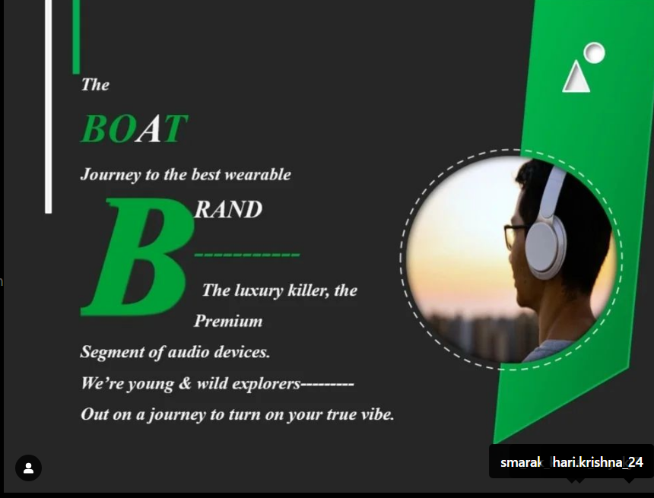
Content creation and curation

Slide 32
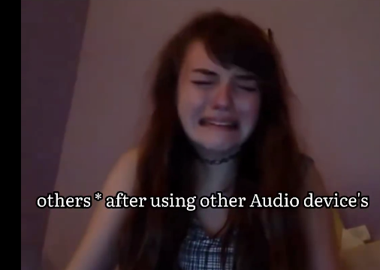
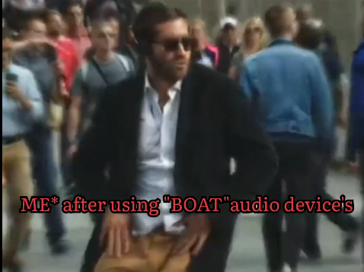
Content sample

Slide 33
Content idea
Above two pictures are the before and after reactions of two different people the lady is frustrated after using the poor quality earphones and in the second picture a man is shown to be enjoying his music in public and he is in pure bliss and the reason behind his joy is the quality of audio provided by bOAt earphones.The whole video has been uploaded in the github account .
Saradhi has taken creative liberty while editing the video to establish boats superiority among other brands.
Since the young generations connects and relates to reels and memes on social media so much,we have added the essence of both reel and meme.

Slide 34
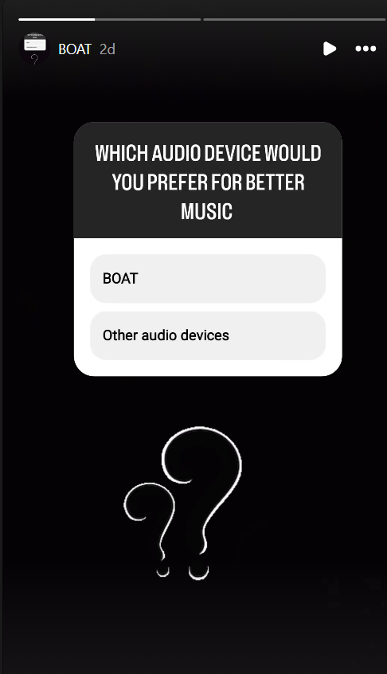
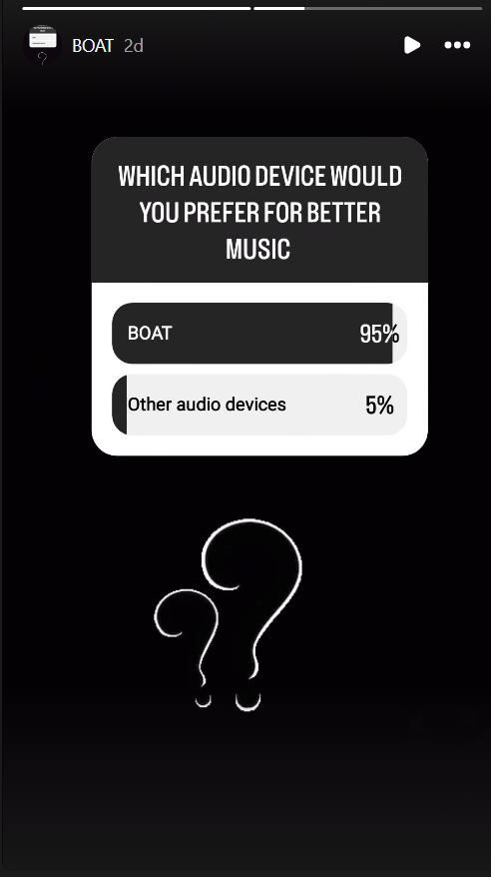
We have uploaded interactive stories on social medias to collects audiences response on BOAT .

Slide 35
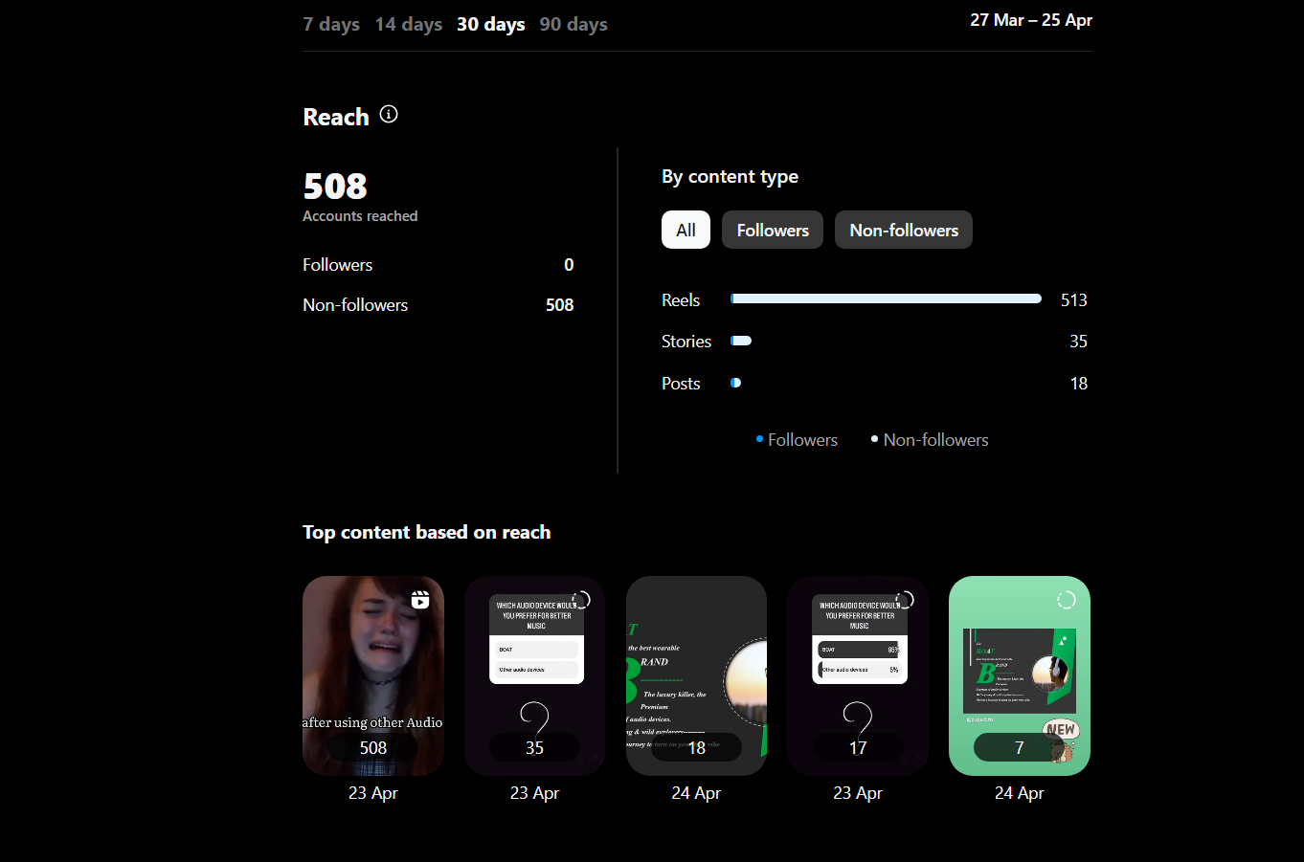
Instagram insights

Slide 36
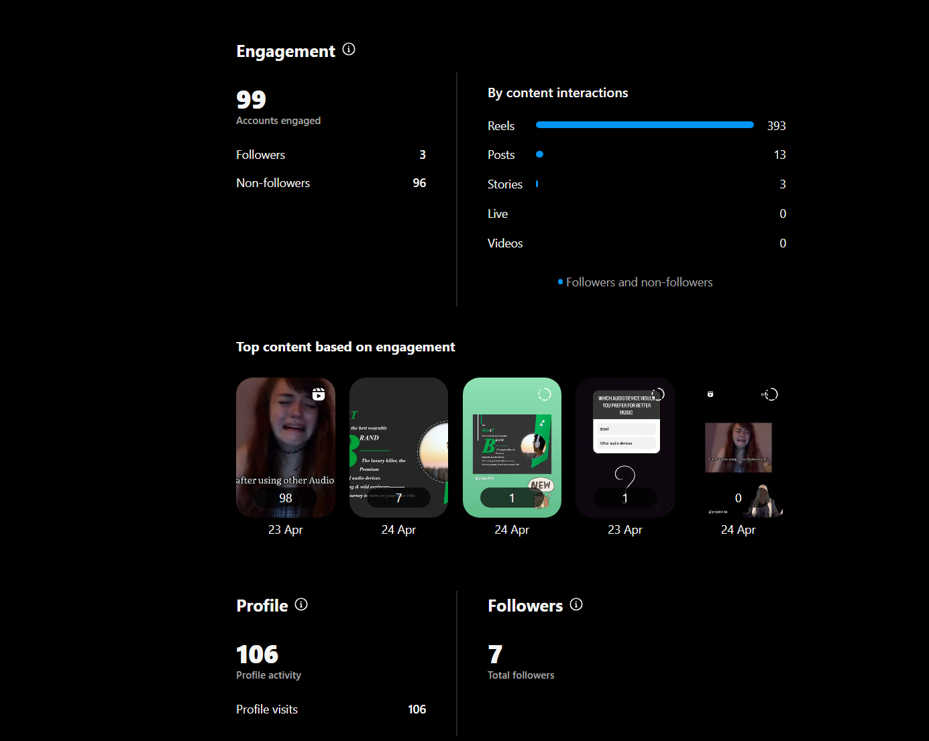
Instagram insights

Slide 37
Lessons learned:
1.consistency is key :consistency in content creation helps to establish brand recognition and build a loyal audience. Maintaining a consistence brand voice, visual identity and posting schedules creates a cohesive brand experience for the audience.
2.Quality over quantity: while it is important to consistently create content, focusing on quality should precedence over quantity. Well produced and thoughtful content tends to have a more significant impact and can lead to higher engagement and brand loyalty.

Slide 38

Thank You

